Slide 1



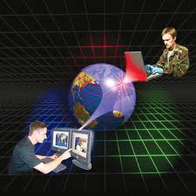
Net 101
NetWorking Essentials I
Career Path
Timothy Daniels

Slide 2
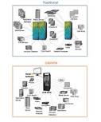



Information Systems Professionals
Serve as Strategic Liaisons between Administrative and Technological functions of an Organization.

Slide 3




Related occupations
Information Systems Manager
Chief Information Officer
Project Manager
Computer Systems Analyst
Systems Administrator

Slide 4




The FBI Estimate Computer Crime
Cost American Businesses
$67.2 bilion Loss
Intrusion By Hackers
2006 Survey

Slide 5




Computer Security Specialists
Protect
Computer Systems
Networks
Against Threats

Slide 6



Baker Online
Network 101
Network 102
CSS 211
Introduction to Network Security
May lead to CCSA Security Certification
Partnership with Checkpoint Software Technology
Certification: CCSA
Degree: Bachelor’s Degree: Computer Information Systems
Thank you
Professor Alexander and Network 101 class

Slide 7

IT Professional Organizations
Association For Computing Machinery
Scientific Educational Organization Promoting Knowledge
Association of Information Technology Professionals
9,000 Members
Both Organizations offer:
Many Chapters in the U.S.
Student and Professional
Workshops, Seminars; Conventions
Publications/Continuing Educations

Slide 8

Sources:

Slide 9
Source:
Discovering Computers, Shelly Gary B; Vermaat, Misty E; Cengage Learning, Boston; MA 02210
Internet:
Internet Kaufman, Clare; December 7, 2011, Computer Security Specialist Salary & Career Outlook,
Retrieved 2/9/2013 from http://www.schools.com/news/computer-security-specialist-salary-career-outlook.html Koening. (1997-2013). Koening World's #1 in offshore training. In Koening Solutions.
Retrieved 2/9/2013, from http://www.koenig-solutions.com/about-koenig-solutions.aspx
Sources:

